Slide 1



LET'S
BEGIN!
Are You Ready?

Slide 2



HANDWRITTEN DEVANAGARI NUMERALS RECOGNITION USING DEEP LEARNING
19CSE456 - NNDL
Asritha - CSE20196
Madhav - CSE20065
Sumanth CSE20076
Anjani - CSE20126

Slide 3


1
Introduction
TODAY'S AGENDA
2
Dataset Description
3
Study of MLP & CNN
4
Classifiers & Optimizers
5
Conclusion

Slide 4







INTRODUCTION
Handwritten Numeral Recognition refers to the task of automatically identifying and classifying handwritten numerals.
The task is challenging due to variations in writing styles, shapes, and sizes of numerals.
Deep Learning techniques offer a promising solution to this problem by leveraging neural network architectures capable of learning complex patterns and representations.

Slide 5
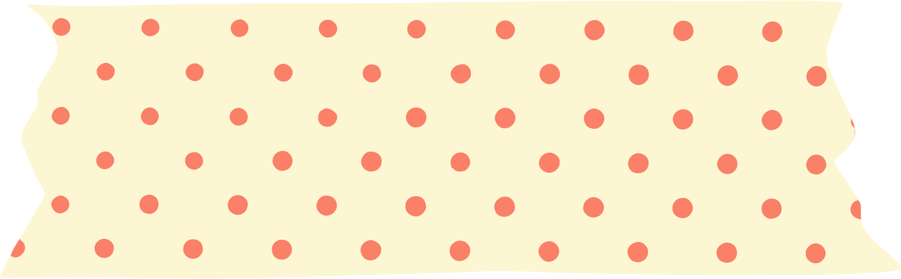

DATASET DESCRIPTION
The dataset used for this project consists of handwritten digit images, each with a resolution of 28x28 pixels. The dataset contains 17,000 images for training and 3,000 images for testing, which were obtained from a folder on the researcher's desktop. The images are in grayscale and have been preprocessed to have pixel values between 0 and 1. The goal of this project is to develop a fully connected neural network that can accurately classify the digits in the images.

Slide 6

STUDY OF MLP
After training and evaluation, the model achieved a test accuracy of 95.09% for the given dataset.
The MLP architecture consists of an input layer, one or more hidden layers, and an output layer.The hidden layers are responsible for learning complex representations of the input data, capturing relevant features and patterns.
Each handwritten numeral image is preprocessed and transformed into a suitable input representation for the MLP.
The image may be resized, normalized, and converted to grayscale.The pixel values of the image are often flattened into a 1D vector to serve as the input to the MLP.
When I go on an online shopping spree - Jannah

Slide 7
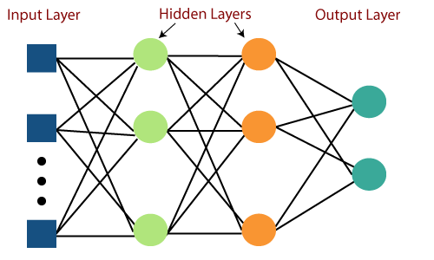
MLP

Slide 8
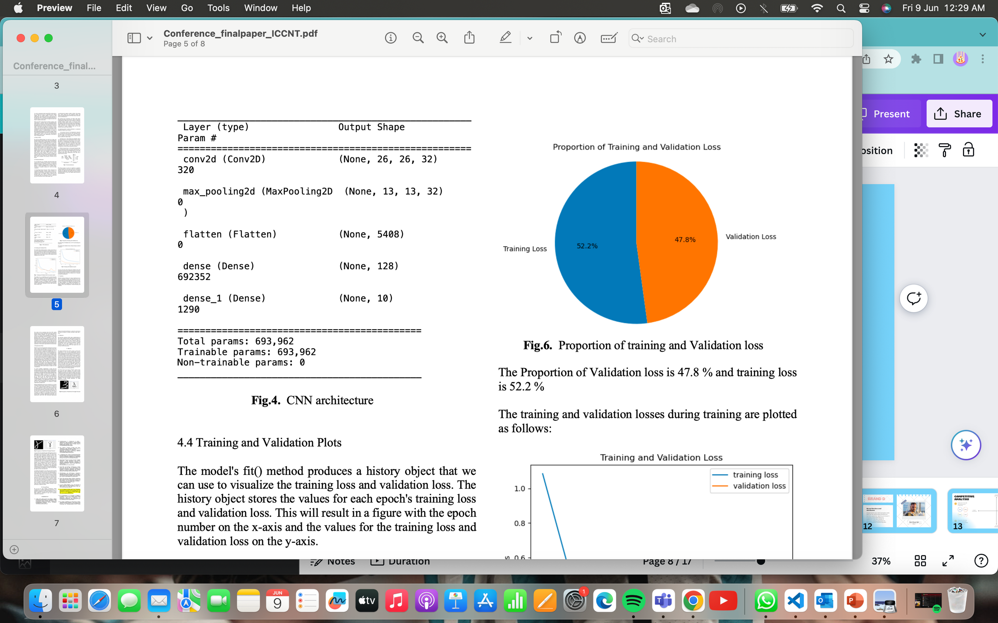
STUDY OF CNN
CNNs are a type of deep learning neural network specifically designed for image recognition tasks.
CNNs consist of multiple layers, including convolutional layers, pooling layers, and fully connected layers.
The Proportion of Validation loss is 47.8 % and training loss is 52.2 %
The performance of CNNs in handwritten numeral recognition is evaluated using various metrics, including accuracy, precision, recall, and F1-score.
According to the data that we were taken, the model classified 98.23% accuracy of the test photos correctly.
Fig.1 CNN Architecture
1
Precision Score - 97.59%
2
Recall Score - 94.76 %

Slide 9

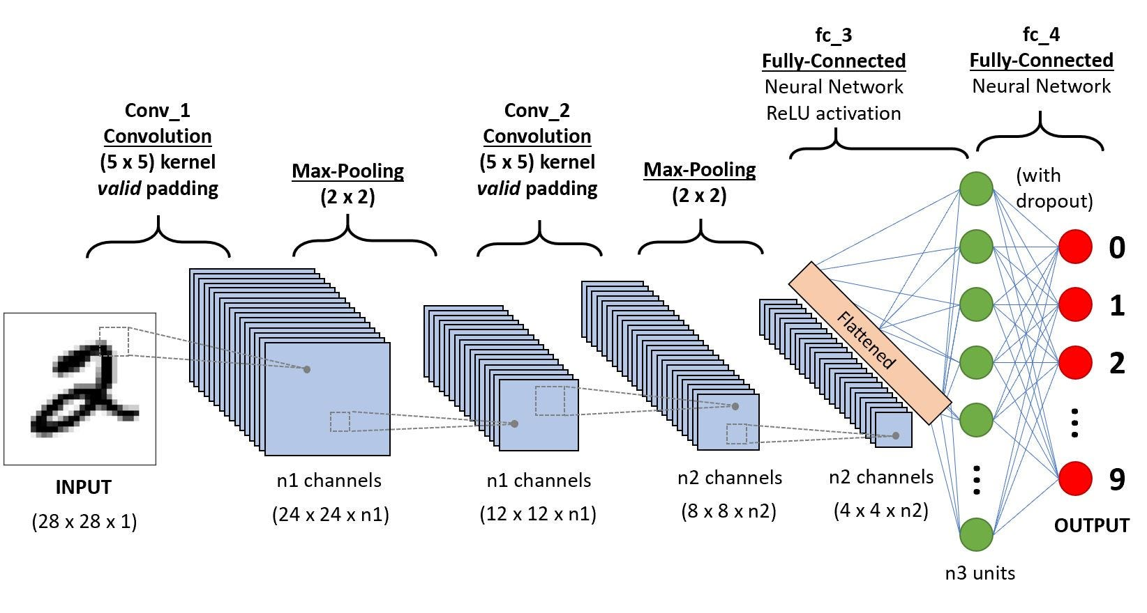

Slide 10


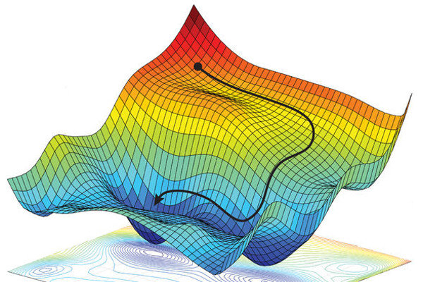
CLASSIFIERS & OPTIMISERS
Stochastic Gradient Descent
Highest Accuracy:0.9867
Lowest Loss:0.0443
For handwritten Devanagari numeral recognition using deep learning, popular classifiers include convolutional neural networks (CNNs), recurrent neural networks (RNNs), and hybrid models. Common optimizers used for training these classifiers are Stochastic Gradient Descent (SGD), Adam, and RMSprop. Proper selection of classifiers and optimizers is crucial for achieving accurate recognition results.

Slide 11
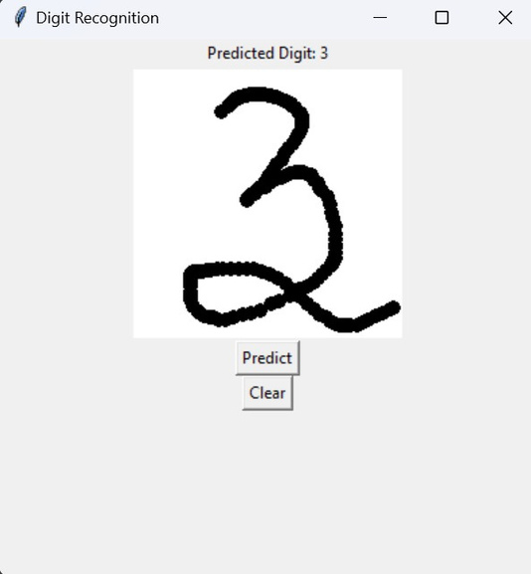

CONCLUSION
OUTPUT
In conclusion, deep learning classifiers, such as CNNs and RNNs, combined with appropriate optimizers like SGD, Adam, or RMSprop, have shown promising results for handwritten Devanagari numeral recognition. These techniques offer a robust and efficient approach for accurately identifying and classifying Devanagari numerals from handwritten inputs, paving the way for various applications in digit recognition and character analysis.

Slide 12



